Slide 1
MARKET STRUCTURE
Samir K Mahajan, M.Sc, Ph.D.,UGC-NET
Assistant Professor (Economics)
Department of Mathematics & Humanities
Institute of Technology
Nirma University
Email: samir.mahajan@nirmauni.ac.in
https://sites.google.com/a/nirmauni.ac.in/2hm203-_-eebm_even_2014/

Slide 2
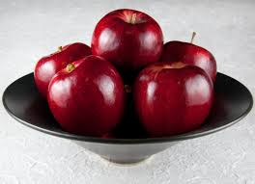
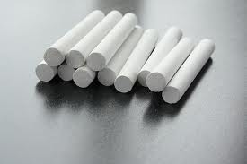
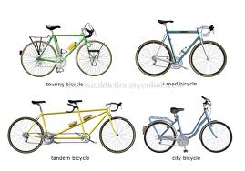
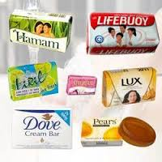

Slide 3
HOMOGENOUS PRODUCTs : IDENTICAL or PERFECT SUBSTITUTES
Example-I
Example-II

Slide 4
DIFFERENTIATED PRODUCTS: SIMILAR BUT NOT IDENTICAL OR DIFFERENT BUT CLOSE SUBSTITUTES
Example-II
Example-I

Slide 5
MEANING OF MARKET IN ECONOMICS
In common language, market means a place where goods are purchased.
However, in economics, market means an arrangement which establish effective relationship between buyers and seller of a commodity.
Hence, each commodity has its own market.

Slide 6
WHAT DETERMINES A MARKET
Nature of the commodity
(homogenous or differentiated)
Buyers and sellers of the commodity
Freedom of entry and exit
Control over supply/output
Control over price

Slide 7
Market Structure
Perfect Competition
Imperfect Competition
Monopolistic Competition
Monopoly
Oligopoly
Duopoly

Slide 8
PERFECT COMPETITION
Perfect competition is a market structure in which large number of sellers sell a homogenous product at uniform price.

Slide 9
PERFECT COMPETITION: FEATURES
1. Large Number of Buyers and Sellers
There are large number of sellers and buyers such that each seller supply a small fraction of the market supply and each buyer buys a small fraction of the market demand. Thus, no single seller or buyer can influence the price and affect the market
2. Homogeneous Products
Products offered for sale by all the sellers are homogenous/ identical in every respect . thus, the products of different sellers are perfect substitutes of one another
3. Uniform price
Price is uniform as the products of the different sellers in the market are homogenous. The price is determined forces of demand(buyer’s bidding) and supply (sellers bidding) in the market and accepted by the all sellers are price takers in market. Hence firms under perfect competition are called price-takers.

Slide 10
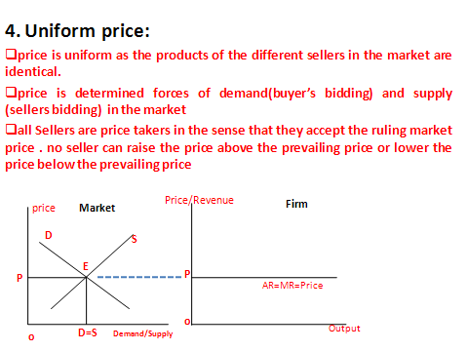
PERFECT COMPETITION: FEATURES (Contd.)
Firms are price takers under perfect competition.

Slide 11
PERFECT COMPETITION: FEATURES (Contd.)
4. Free entry and exit
There is be no restriction on the entry and exit of both buyers to enter the market/industry.
5.Perfect knowledge about the market
Both buyers’ and-sellers must have perfect knowledge about the conditions of the market such about ruling market price, the product. Hence, there is no selling cost incurred by the firms/sellers.
6. Perfect mobility
Various factors of production are perfectly mobile within the industry. Factors of production can freely move from one occupation to another and from one place to another, one firm to another. There is no barriers on their movement.

Slide 12
8. Perfectly elastic demand curve
Demand curve reflected by AR curve facing firm under perfect competition is perfectly elastic meaning that the firm can sell as much as it want at the ruling market price . Since price is uniform and given under perfect competition, both AR(price) and MR become equal. Thus, AR and MR curves coincide and become parallel to output axis.
PERFECT COMPETITION: FEATURES (Contd.)
7. Absence of transport cost
Transport cost is zero. price of the product is not affected by the cost of transportation.
Revenue
Demand curve
p
AR=MR=Price
0
Output Sold

Slide 13
.
Monopoly
Monopoly is a form of market structure where there is a single seller producing a commodity having no close substitute.
The word monopoly is derived from two Greek words-Mono and Poly. Mono means single and Poly means 'seller'. Thus monopoly means single seller.

Slide 14
MONOPOLY: FEATURES
1.One seller of a commodity
The characteristic feature of single seller eliminates the distinction between
the firm and the industry. Single seller itself constitute the industry .
2. No close substitute
Product of the monopoly firm has no close substitutes .
3. Strong barriers to the entry into the industry
Entry to the industry is restricted as the single firm imposes barriers to the entry of new and potential rivals in the industry.
.

Slide 15
MONOPOLY: FEATURES(contd)
4.The firm is price-maker
The firm is price-maker in the sense that the seller fixes the price of its product. The firm, thus, has independent price policy.
5.Price-discrimination may be possible
The firm may charge different prices from different set of customers for the same product or services.
(**Price discrimination is charging different prices for the same product or services from different consumers on the basis of personal, place and trade. )
.

Slide 16
6. Downward sloping inelastic demand curve of a monopoly firm
Demand curve of a firm reflected by its AR curve under monopoly is downward sloping meaning that the monopoly firm can sell more at a lower price and less at a higher price. The demand curve of the monopoly firm is highly inelastic. This is because the product does not have any close substitute.
Revenue
MR curve of the monopoly firm is also downward sloping and lies bellow MR curve lies below AR curve.
AR
MR
0
Output

Slide 17
Monopolistic competition is a market situation in which both monopoly and competitive elements are present.
The most distinguished features of monopolistic competition which makes it a blending of competition and monopoly is product differentiation.
(** Product differentiation refers to the actively created differences in products with respect to brand, trademark, design, packing, colour, size, measurement, weight such that though the products are similar, they are not identical or in other words the products are different but closely related.
Examples: Soaps lux, liril, cinthol, pears, hamam)
Bike (hero, honda, suzuki, bajaz and so on)
Monopolistic Competition

Slide 18
1. Many sellers
There many sellers or firms in the industry such that individual firm is incompetent to affect the price of the industry.
2. Differentiated Products
Product differentiation is an important feature of monoploy. Products of different sellers are differentiated such that they are close substitute of each other with high degree of cross elasticises.
3. Relatively free entry and exit
New firm can enter the industry or any existing firm can leave the industry.
4. Each firm may have a tiny ‘monopoly’ because of the differentiation of their product
As the products are differentiated, they are unique in their own right. Each firm thus enjoys some degree of monopoly over its product.
Monopolistic Competition: Features
.

Slide 19
Monopolistic Competition: Features(contd.)
5. Firm has some control over price
A firm under monopoly can influence the price of its product to some extent.
Presence of selling cost
The firms bears selling cost such as expenses on advertisement, publicity etc to create customer base and loyalty.
(*** Selling costs are the expenses incurred on advertisement, publicity, salesmanship etc. Selling costs are incurred by the firms to make aware of the product, to attract new customers, to create customer base and loyalty).

Slide 20
7. Downward sloping highly elastic demand curve of a firm under monopolistic competition
Demand curve of a firm reflected by its AR curve under monopolistic competition is downward sloping. The demand curve is highly elastic. This is because differentiated products under monopolistic competition has more close substitutes.
Revenue
MR curve of a firm under monopolistic competition is also downward sloping and lies bellow MR curve lies below AR curve.
AR
MR
0
Output

Slide 21
OLIGOPOLY
Oligopoly is a market situations in which there are few (more than two) sellers of a commodity such that actions of every seller has predictable effect on the other sellers/rivals.
Hence, oligopoly is also called competition amongst the few.
Oligopoly may be of two types can two forms:
pure oligopoly or oligopoly without product differentiation.
differentiated oligopoly or oligopoly with product differentiation.

Slide 22
Oligopoly : Features
1. Industry dominated by small number of large firms
2.High barriers to entry
3. Products may be highly differentiated ( branding) or homogenous
4. Every seller has predictable impact on the other
5. Active presence of non-price competition such as selling and advertisement costs.
6. High degree of interdependence between firms and each firm take into account the reactions of others while making its own decisions
7. There may be price-rigidity (price stability) or price war within the market

Slide 23
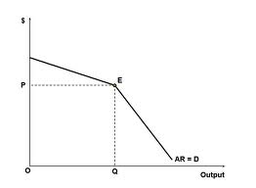
PRICE-RIGIDITY AND PAUL SWEEZY’S KINKED DEMAND CURVE
Sweezy argued that an ordinary demand curve does not apply to oligopoly markets and promotes a kinked demand curve.
Kink demand curve has a kink(E) at the prevailing level of price (P).
the segment of the demand curve above the kink is highly elastic
the segment of the demand curve bellow the kink is highly inelastic

Slide 24
Price-rigidity and Paul Sweezy’s Kinked Demand curve contd.
If the oligopoly firm reduce the price bellow the prevailing price (at kink), his rivals will follow him and accordingly lower their price. Very little increase in the sale can be obtained by a reduction in price by the oligopolist.
If the oligopoly firm raises the price above the prevailing price (at kink), his rivals will not follow him. Large fall in sale is expected if the oligopolist by a increase in price.
Hence the oligopolist has no incentive to raise its price or reduce it. Hence there is price rigidity/stable price in the market.

Slide 25
Oligopoly (contd)
Collusive Oligopoly
Setting price independently is rare in oligopoly. Usually some collusion (understating/agreement ) takes place among the oligopolists in a particular industry. Such agreement may be formal (open) or tacit (secret).
Collusive oligopoly prevails when there is some agreement among the oligopolists with respect to price or output. Formal agreements to form monopolies are illegal in most countries. Hence understanding are generally tacit or secret.
Cartel is formed in the particular industry when oligopolists collude by making some formal agreements.
OPEC(Organisation of Petroleum Exporting Countries) is the most successful story of an international cartel in which some petroleum rich countries joined together in 1960 to to coordinate the policies of the oil-producing countries. During 1970s, OPEC began to gain influence and started regulating oil supply in international market which steeply raised oil prices specially since 1973.

Slide 26
DUOPOLY
Duopoly is a market situation in which there are two sellers of a commodity such that actions of each seller has predictable effect on the other seller/rival.
.

